Slide 1
Good Health & Wellbeing
Group 7
Demir Dereli - Yasemin Kose - Maryam Hajiyeva – Ahmet Anter Yagiz – Okan Sarp Kaya

Slide 2
The reasoning
One of the main objectives of United Nations is to Reduce the number of deaths illnesses from hazardous chemicals and air, water and soil pollution and contamination (Goal 3.9)
We felt that as individuals we don’t have many ways of combatting pollution but it affects our daily life and health tremendously
We wanted to create a tool that allows us to escape from this pollution and spend our free time in clean areas
People currently don’t have the tools avoid pollution when planning their activities even if they are conscious of their choices.
The current applications that are on the market don’t have the features we were looking for

Slide 3
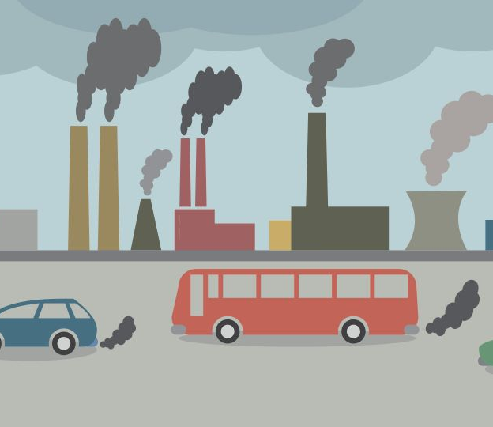
Consequences of Air Pollution on Health
Air pollution is measured with Particulate Matter (PM)
High PM:
Increases Premature Death
Increased rate of lung cancer and health diseases
Short term respiratory infections
Less productivity and Mental Strength
Increases mental and body fatigue

Slide 4
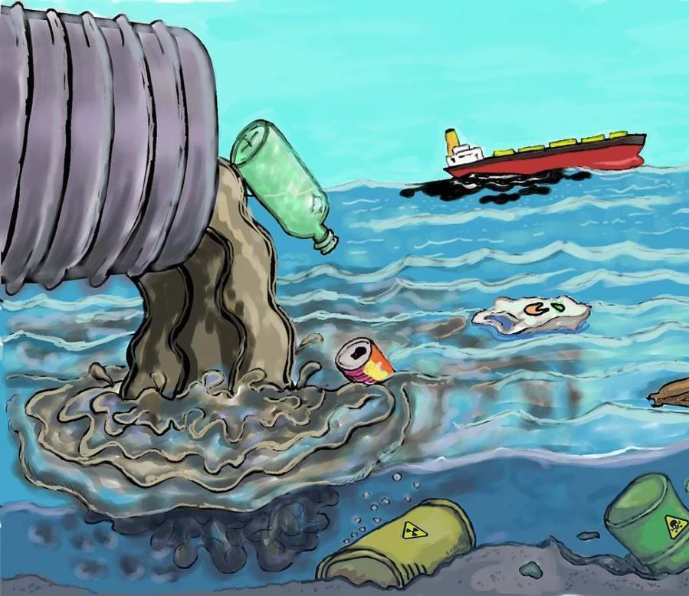
Consequences of Water Pollution on Health
Creates respiratory diseases
Increases Cancer Rate
Creates Reproductive system diseases
Causes diarrheal
Causes Neurological and Cardiovascular diseases

Slide 5
Project Idea
Create an app that enables a person to escape from the harsh reality of air and water pollution in their area and help people make conscious decisions in their daily lives
In the short term it is more feasible to avoid pollution as individuals rather then clean it
App Features
Have a map that shows air and water pollution in their area
Recommend places for specific activities that have the least amount of pollution
Travel to the selected locations using routes that have the least pollutions
Be informed about ways to combat pollution in their daily life

Slide 6
The Goals
Reduce
Reduce health implications of Air and Water Pollution
Help
Help people notice the increase in quality of life when in clean areas
Allow
Allow people make conscious choices about their life
Increase
Increase the awareness about Pollution

Slide 7
The Plan
Create an IOS App using Swift & Swift UI
Use Azure for IOS Services for:
Data Storage
User Management
Authentication
AI and ML Services (For place recommendation and path generation)

Slide 8
Thank you for listening
We are more than welcome to hear feedback from everyone

